Slide 1



Game Playing with Monte-Carlo Tree Search
Presentation by
Alexandra Danciu

Slide 2
Introduction
What is Monte-Carlo Tree Search?
How does it work?
Why is it cool?
How will I be using it in this project?
What has been my approach so far?
What are my next steps?

Slide 3
What is the algorithm?
A tree search algorithm, an algorithm for searching trees.
Monte Carlo Tree Search (MCTS) is a decision-making algorithm commonly used in games and similar applications. It utilizes randomness and statistical methods to explore large decision trees efficiently. The process involves four main steps:
Selection
Expansion
Simulation
Backpropagation
MCTS is a powerful tool in AI, enabling intelligent and adaptive gameplay in environments like Go, Chess, and Connect4 without needing exhaustive computations.

Slide 4
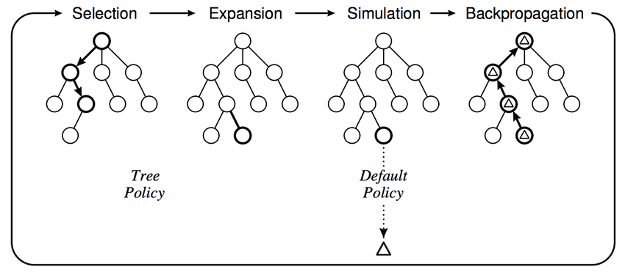

Slide 5
How will it be used in this project?
Monte Carlo Tree Search (MCTS) is an effective algorithm for creating AI in games like Connect4, where the decision space is large. By simulating multiple potential moves and analysing their outcomes, MCTS enables the AI to make informed decisions without exhaustive search.
This makes it a powerful tool for developing an AI opponent that is both challenging and dynamic.
Using MCTS in Connect4 not only showcases the algorithm’s capability to handle complex decision-making but also provides an engaging way to demonstrate AI in action.

Slide 6

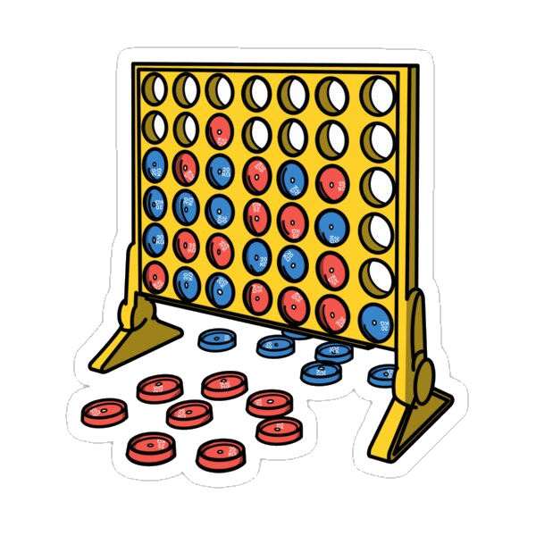
Progress so far
Bandit Problem Proof of Concept
Connect4 Proof of Concept

Slide 7
Further Steps
Researching into GUI interfaces to implement for the game
Modifying the Connect4 proof of concept to work
with one real player and an AI opponent
Using my knowledge from the bandit problem proof of concept
and the research done into the Monte Carlo Tree Search Algorithm
to successfully code an AI opponent to play Connect4.

Slide 8

Any Questions?
& Thank You for Listening

